Slide 1


Slide 2
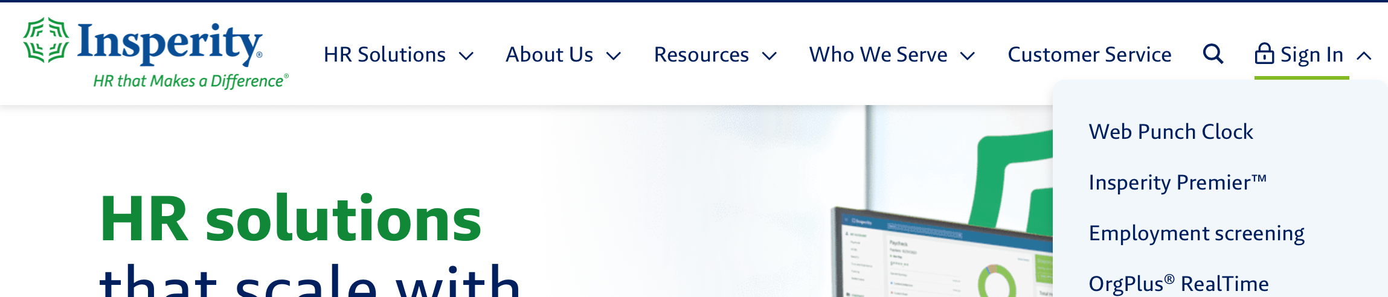
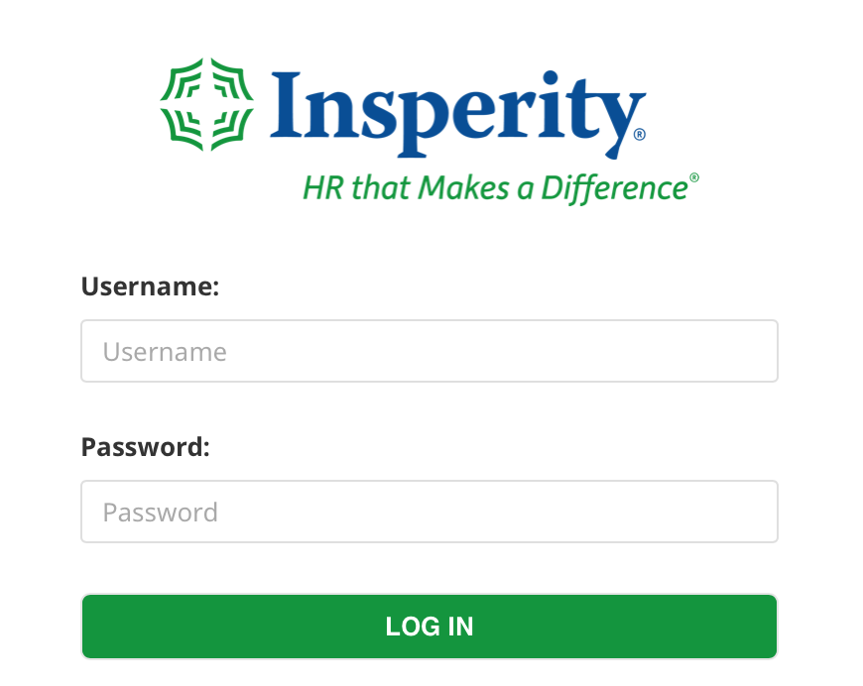
Insperity Premier

Slide 3
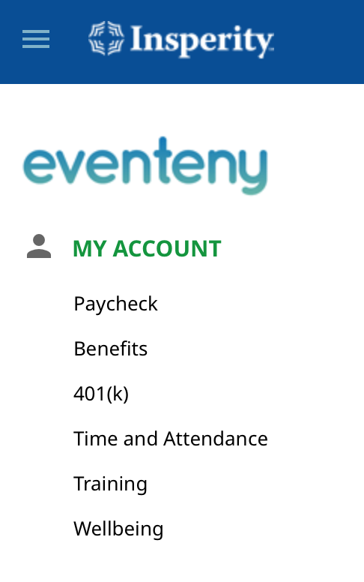
Insperity Overview
Paycheck: paystubs, year to date pay, tax documents (W-4s, W-2s), direct deposit
Benefits: Health, Dental, Vision, Life, Beneficiaries, dependents, & more
401(k): workplace retirement plan
Time and Attendance: PTO/Sick time, hour tracking
Training: hundreds of training sessions
Wellbeing: employee assistance program, fitness programs, financial coaching, continued education

Slide 4
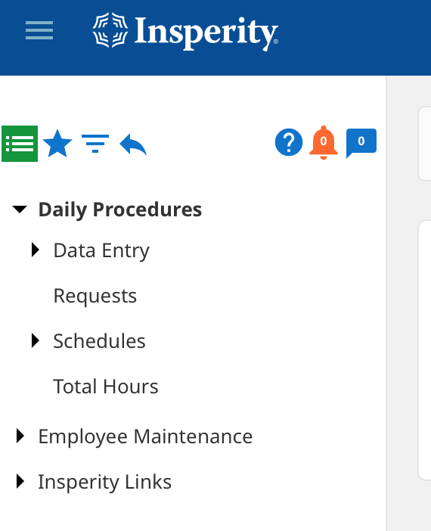
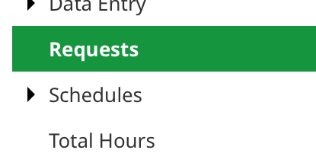
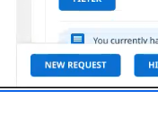
PTO First Step
Bottom left

Slide 5
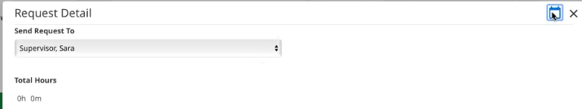
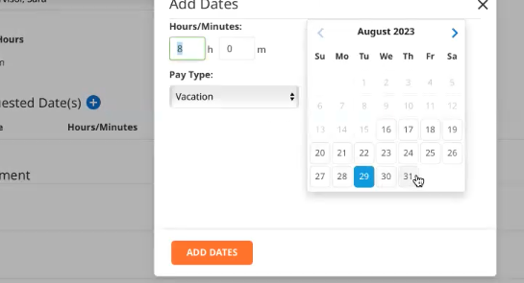
Paid Time-off Requests
This step will have your supervisors name (who the request is going to)
You will only be able to select dates outside of the current pay period, other requests will have to be manually put in by your supervisor

Slide 6
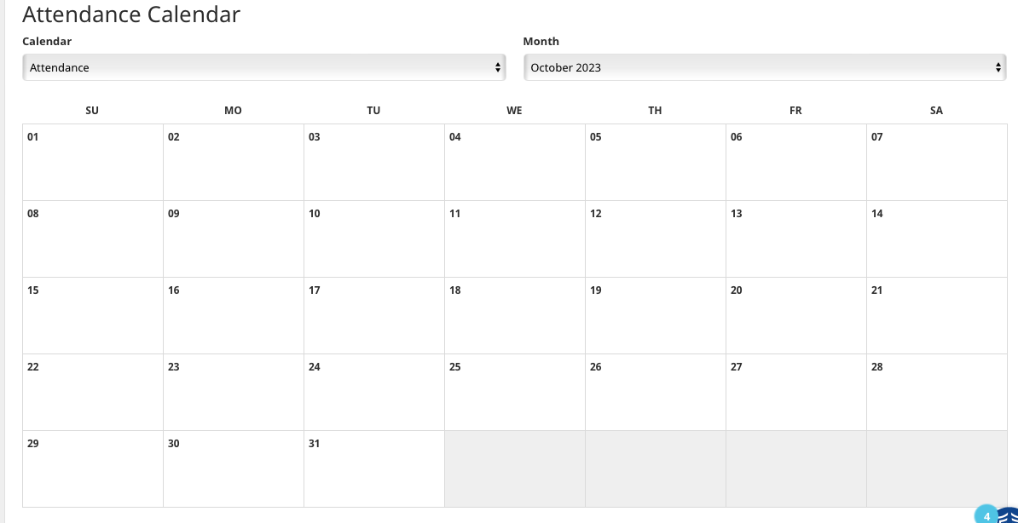
Attendance Calendar
You can see when other people are going to be out of office.
This is a good tool to use to see if any other team mates will be out at the same time.

Slide 7
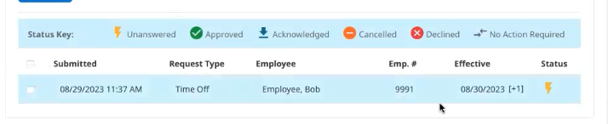
PTO Status

Slide 8
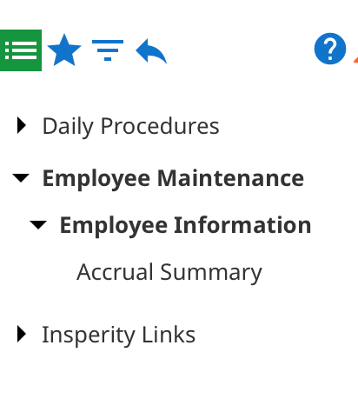
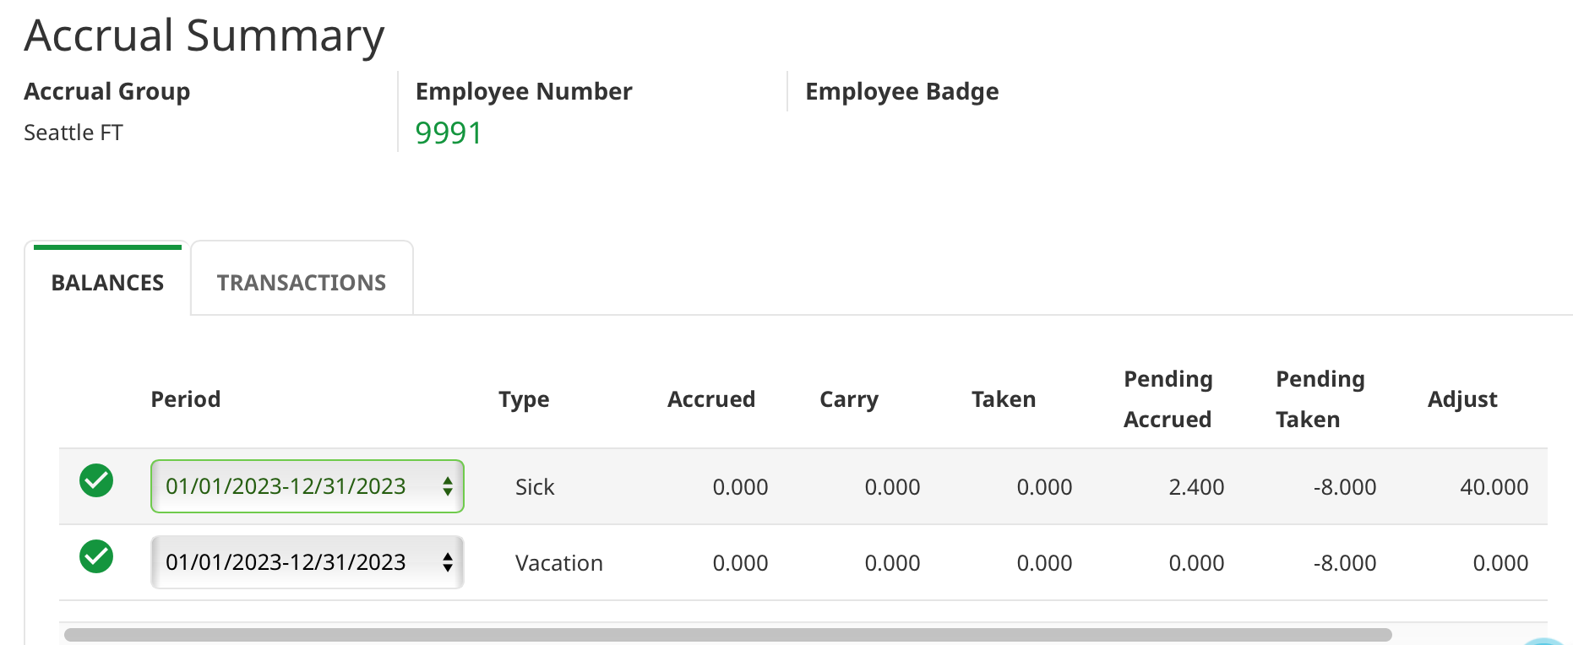
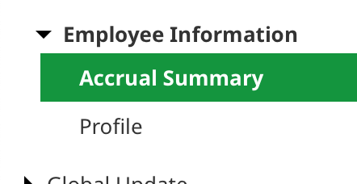
Amount Taken/ Accrual Summary
***PTO will show up as a negative***

Slide 9

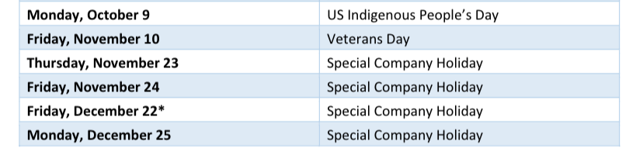
Questions?

